Slide 1
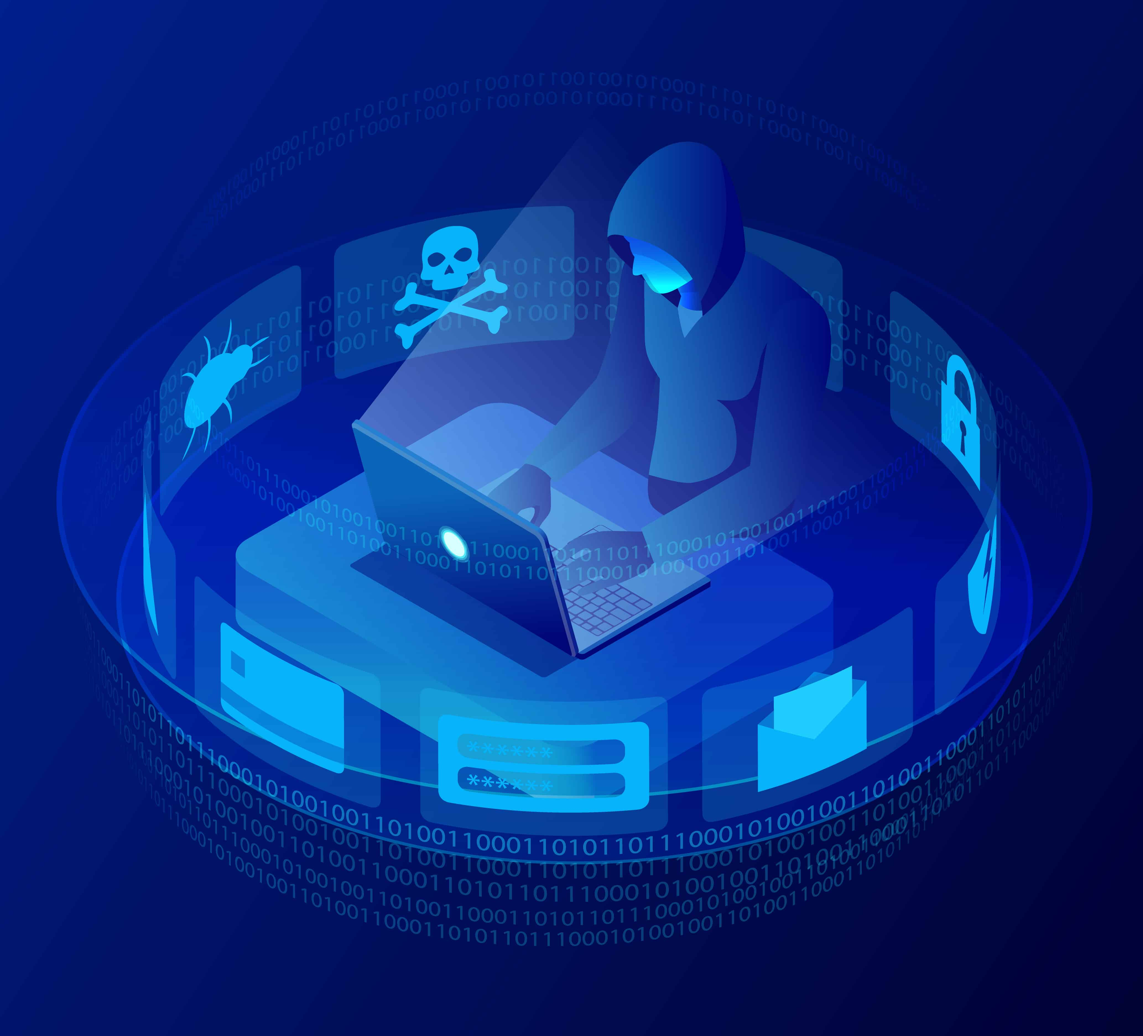
New England Hospital Security Report
(Talk about what it is, 1st of its kind, opened Maidstone Kent, 4 may 2022 services for covid and provides 300 beds for rehabilitation)

Slide 2
Things explored
An assessment of the New England Hospital overviewing:
Security issues
Vulnerabilities Identified
Mitigation strategies
Cloud Computing
Legal

Slide 3
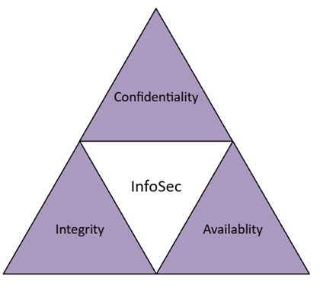
Why Security is Needed?
Information security (InfoSec) is the protection of both physical and digital information against unauthorised access, disclosure and disruption/alteration. (IBM, 2024, What Is Information Security? | IBM)
Why is infoSec important?
Prime target for attacks due to
value and importance (NHS Synnovis Ransomware Attack, up to 300 million records including patient data were stolen, June2024)
Keep data secure (and protected
against internal or external damage)
Reduce Risk of security breaches
Mitigate and remediate damage in
case of breaches
Maintain the principles of CIA
(Foundational to InfoSec, what it means?
preventing unathorised access
Preventing tampering to ensure authenticity and
reliability, data available when needed by authorised personnel in org)

Slide 4
Industry Standards
(2 primary recognised standards which help validate a companies proficiency in the InfoSec field)
ISO/IEC 27001
- Provides guidance for improving ISMS (Information Security Management System)
- Provides a centralised framework
- Provides certification is known universally for quality
NIST SP 800/30
- Alternative to ISO/IEC 27001
- Provides a Risk assessment guideline
The NIST standard was used as a guideline for the vulnerability risk assessments as it is focused on risk assessments which is what this report is prioritising

Slide 5
Hospital IT Infrastructure
(Services operating on)
Workstations using Windows 8 or 10
Servers working on Windows 2016, 2019
Legacy Windows XP systems
Online Web Services via Internet to access records
(Patient Information held on)
Linux based SQL servers
J2EE Java Glass Fish application servers
(Login system built through Java Resource Adapter Architecture)
Active directories, web servers, SQL databases

Slide 6
Risk Assessments
Risk assessment was developed via online research on vulnerabilities within systems using CVE
Data was laid out in tables
Use of Penetration testing

Slide 7
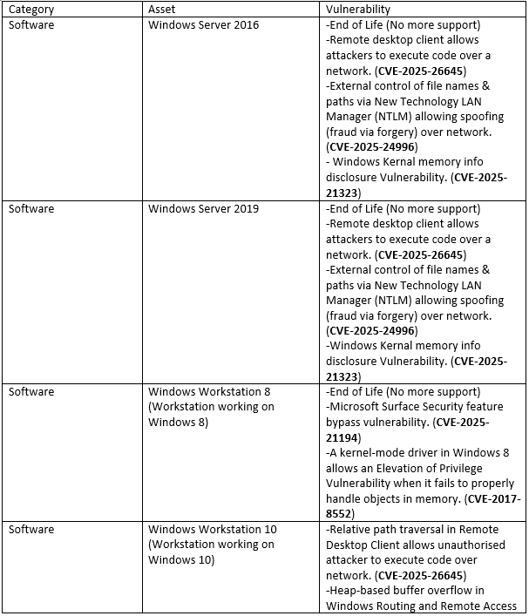
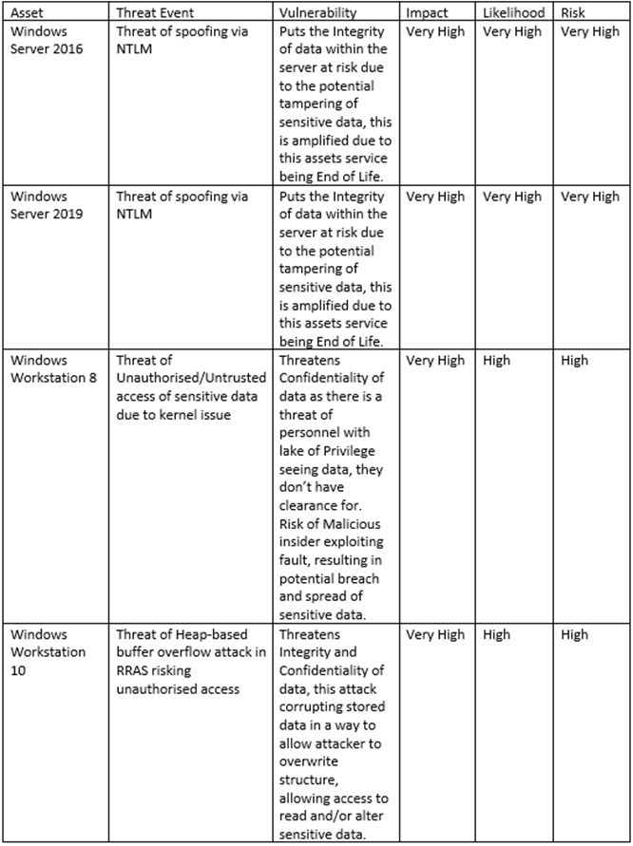
Identified Issues and Threats
Sample of what risk assessment tables looked like 1 focuses on a list of vulnerabilities found via cve, 2nd focuses on risk calculation of specific vuln
End of Life
Spoofing
DoS/DDoS
SQL Injections
Phishing
Escalation of Privileges
Outdated Hardware
These issues are easily
solveable via the
implementation of the
lacking systems and
the updating and improvement of current systems

Slide 8
Penetration Testing
Kali Linux (Open source, modular and over 300 tools preinstalled for exploiting)
nMap & Metasploit (Network scanning Windows 10 allowing Metasploit) (Windows exploit via EternalBlue)
TheHarvester (Sniffing data, acquiring emails, domains, hosts etc)
ShellPhish (Phishing to take input logins from mimic site)
SQL Map (SQL Injections to acquire database info)
OpenVAS performs vulnerability scans and makes reports

Slide 9
Mitigation Strategies
Upgrade to New Systems
- e.g. Windows Server 2022 and Windows 11 (these may require higher specifications on hardware that the old hardware may not have, as a result having to upgrade hardware (cost)
- Have better security protection and features to mitigate threats
- Can help resolve and mitigate risks relating to End of Life and Legacy
Implement Firewalls
- Protect network against unauthorised access via controlling network traffic
- Protects against SQL Injection, Heap-based Buffer overflow, Malware, DoS/DDoS, Brute-force attack

Slide 10
Mitigation Strategies
Implement Two Factor Authentication / External Approval System
- Access requires two levels of identification
- If Login info is breached, the threat is reduced as second clearance is required
- Protects against Phishing, Brute-force attack, Keylogging
Improve Security and Access Control
- Restricting access to resources via regulating who can view resources based on clearance/role
- Protects against Unauthorised access, Privilege escalation, Brute-force attack, Phishing

Slide 11
Mitigation Strategies
Implement Antivirus
- Scans system for viruses and other digital threats and eliminates them
- Protects against Malware
Implement Encryption
- Converting plaintext into ciphered text which makes it unreadable without the decryption key (only the two intended users have access to the keys)
- Protects against Brute-force attacks, Phishing, Man-in-the- Middle, SQL Injection, DoS/DDoS

Slide 12
Mitigation Strategies
Implement Network Segmentation
- Divides network into smaller isolated networks
- Limits damage by restricting damage to only the breached segment It doesn’t Protect in a similar way to other strategies,
Implement Packet Filtering
- Passes and blocks data packages based on IP source, ports and protocols
- Protects against DoS/DDoS, Malware, Spoofing

Slide 13
Cloud Computing
What is Cloud Computing
The use of remote servers via the internet (as a host) to handle and manage data
Why to move to Cloud Computing
Flexibility (quick to adapt to changes), Efficiency (reduce operational costs) and Innovation (adopts new tech faster)
Inbuilt Security and security expert associates in provider orgs
Disadvantages of Cloud Computing
Reliant on internet connectivity (if there is an outage, these risk to accessibility, however in the world based and reliant on the internet, this risk will naturally reduce)
Expensive upfront investment and maintenance

Slide 14
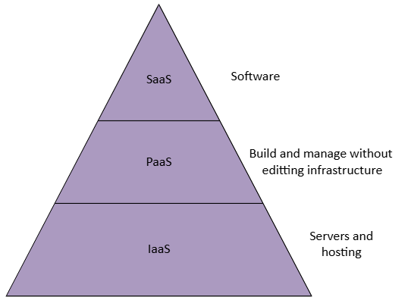
Cloud Computing
3 Main Cloud Platform Providers:
(Which are gdpr compliant)
Amazon Web Services (AWS)
- Offers a wide scale of security services such as encryption Monitoring and Logging
Microsoft Azure
- Provides a wide scale of security tools similar to AWS but also provides tools suck as Identity and Access Management (IAM)
(IAM manages user identities and access permissions) (currently used by NHS)
Google Cloud Platform (GCP)
- Specialises in data encryption and analytics

Slide 15
Cloud Computing - Migration
Theres 6 migration approaches we could choose to move to cloud
1 Rehost – Moving data as is
2 Refactor – Move with small changes to fit the cloud
3 Replatform – Move with upgrades
4 Rebuild – Start completely new
5 Replace – Use a cloud-based app instead
6 Retire – Remove things that are not needed

Slide 16
Legal and Social Repercussions
Legal repercussions for not following guidelines (report breaches to supervisory authority with 72 hours Personal data breaches: a guide | ICO)
Fines (17.5 million or 4% of total turnover Penalties | ICO) (eg British airways got a 20million fine)
Loss of Data (Loss of Data means organisation cannot run accordingly)
Criminal Charges
Loss of Credibility, Trust and Reputation (If theres been a breach and people have been affected, they are less likely to trust the organisation and use it)
Damage to Systems
Danger to Patients and Staff (Malicious Characters holding private data which may be used for ransom, Impersonation, fraud)

Slide 17
Conclusion
Explained why Security is needed
Overviewed Hospital Assets
Identified vulnerabilities
Provided Mitigation Strategies
Cloud Computing
Legal and Social Repercussions

Slide 18
References
IBM, 2024, What Is Information Security? | IBM
Kali Linux – Exploitation Tools | GeeksforGeeks
Personal data breaches: a guide | ICO
Penalties | ICO

